Slide 1
WOODBUN
CUSTOMIZED TO YOUR NEEDS
UTTARPARA
METIABURZ
globalbusinessventures2019@gmail.com

Slide 2
01
02
03
04
About Me
What I Do
Experience
My Work
Here you could describe the topic of the section
Here you could describe the topic of the section
Here you could describe the topic of the section
Here you could describe the topic of the section

Slide 3
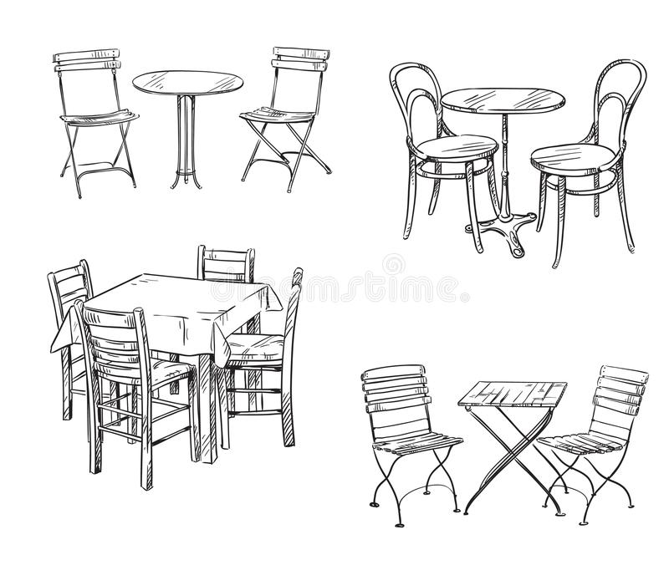
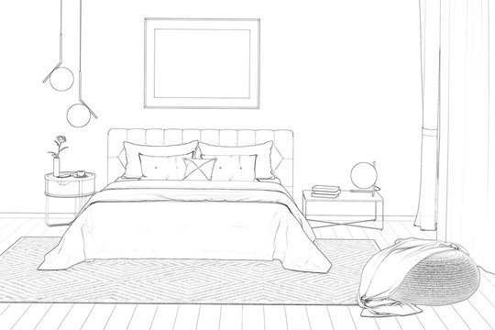
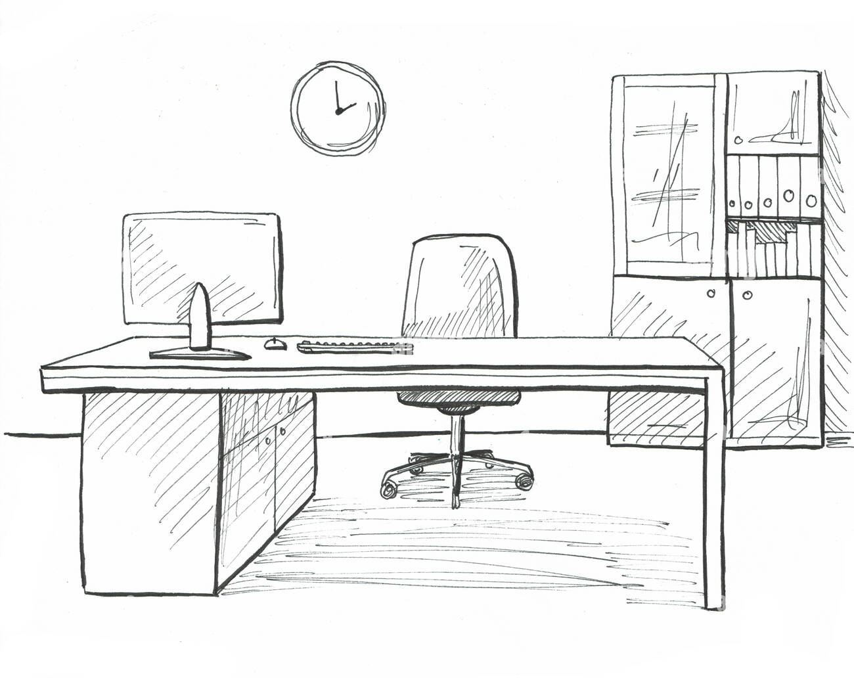
Product Line

Slide 4
Project Furniture
Restaurants
Hotels
Corporate Offices
Government Offices
Hospitals

Slide 5
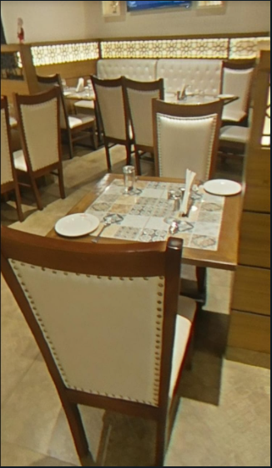
Karim’s Restaurant
Hatibaghan
Delivered 80 seater restaurant furniture along with tables.
The project was achieved within 18 days.

Slide 6
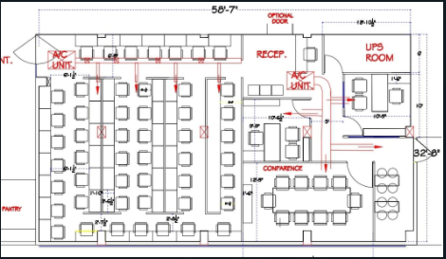
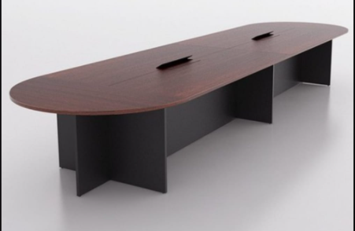
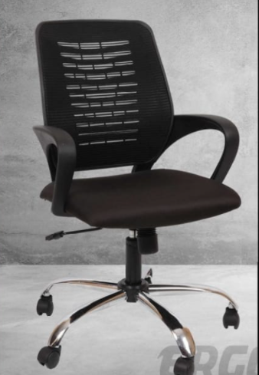
Byju’s
Ongoing project
Jharkhand
project
Lowest cost solution

Slide 7
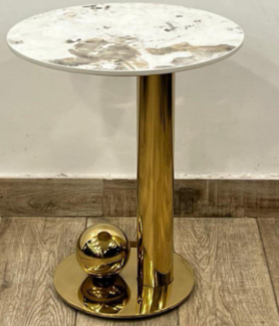
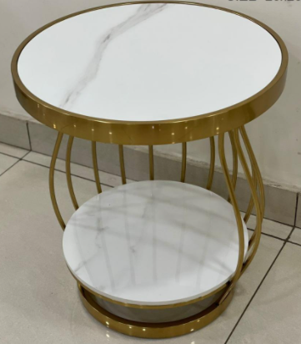
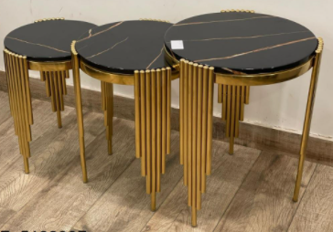
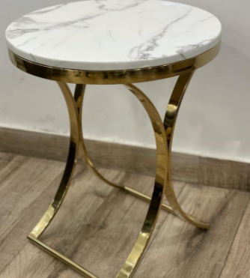
SIDE TABLE
New Arrival

Slide 8
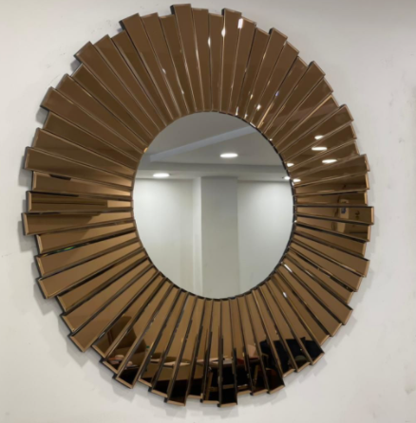
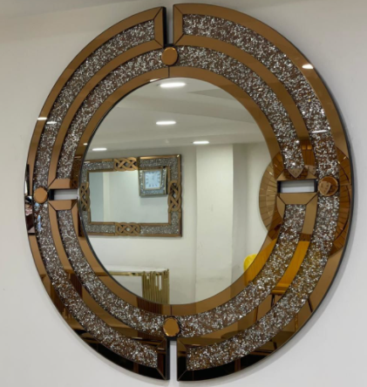
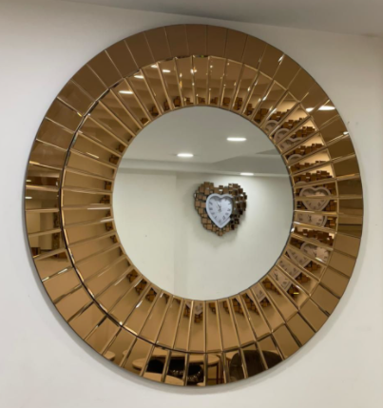
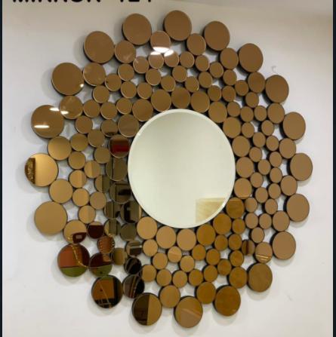
WALL MIRROR
New Arrival

Slide 9
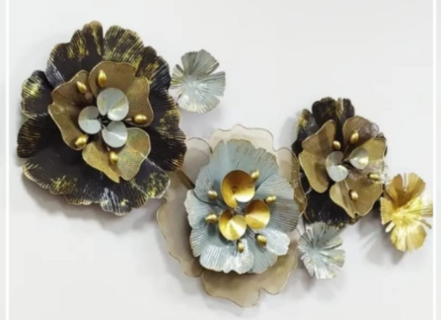
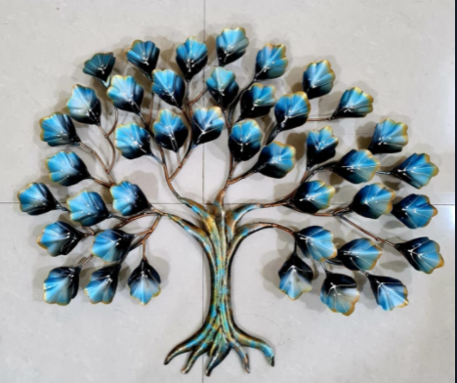
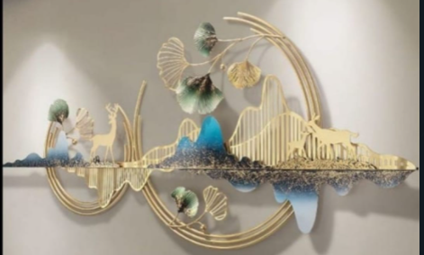
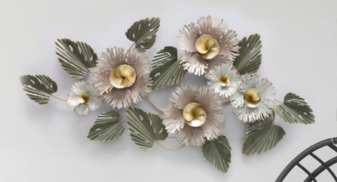
METAL ART
New Arrival

Slide 10
THANK YOU

